Slide 1
Stakeholder Meetings

Slide 2
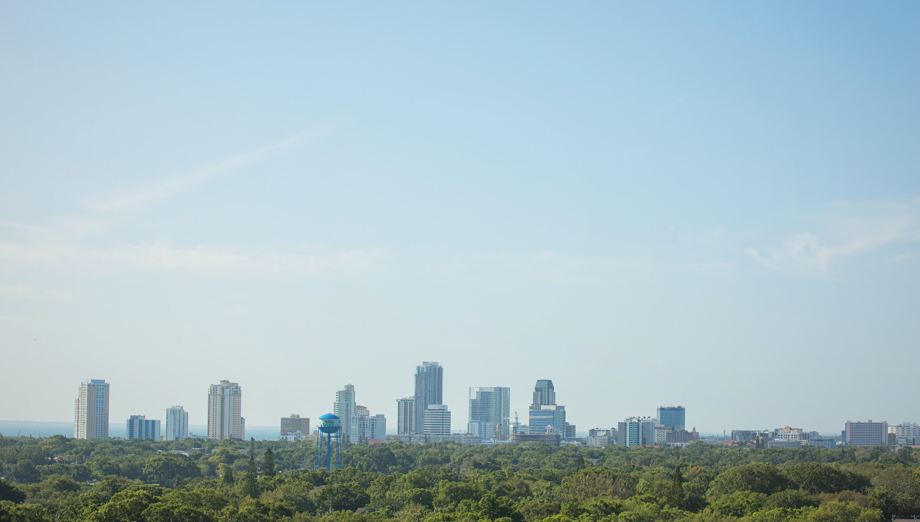
AGENDA
Welcome
Study Overview
Project by Project
Wrap-Up & Next Steps
01
02
03
04

Slide 3
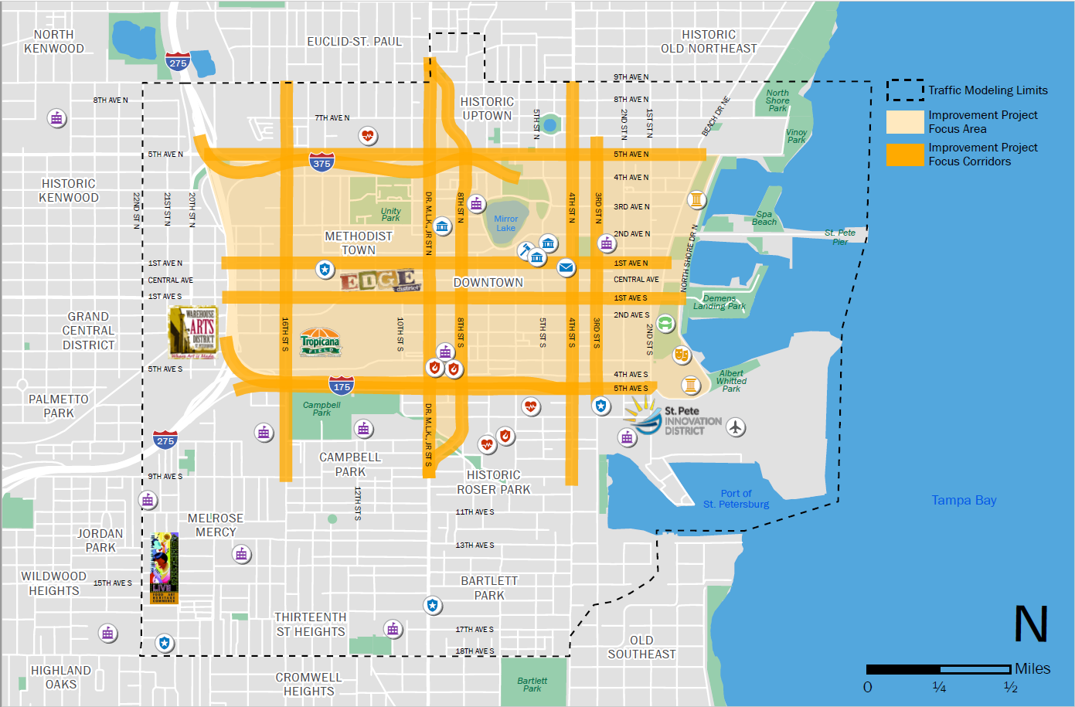

STUDY GOALS
Define a vision for multimodal mobility in greater Downtown St. Petersburg (DTSP)
Test improvement strategies against mobility, livability and economic vitality performance measures
Identify projects and programs to advance

Slide 4
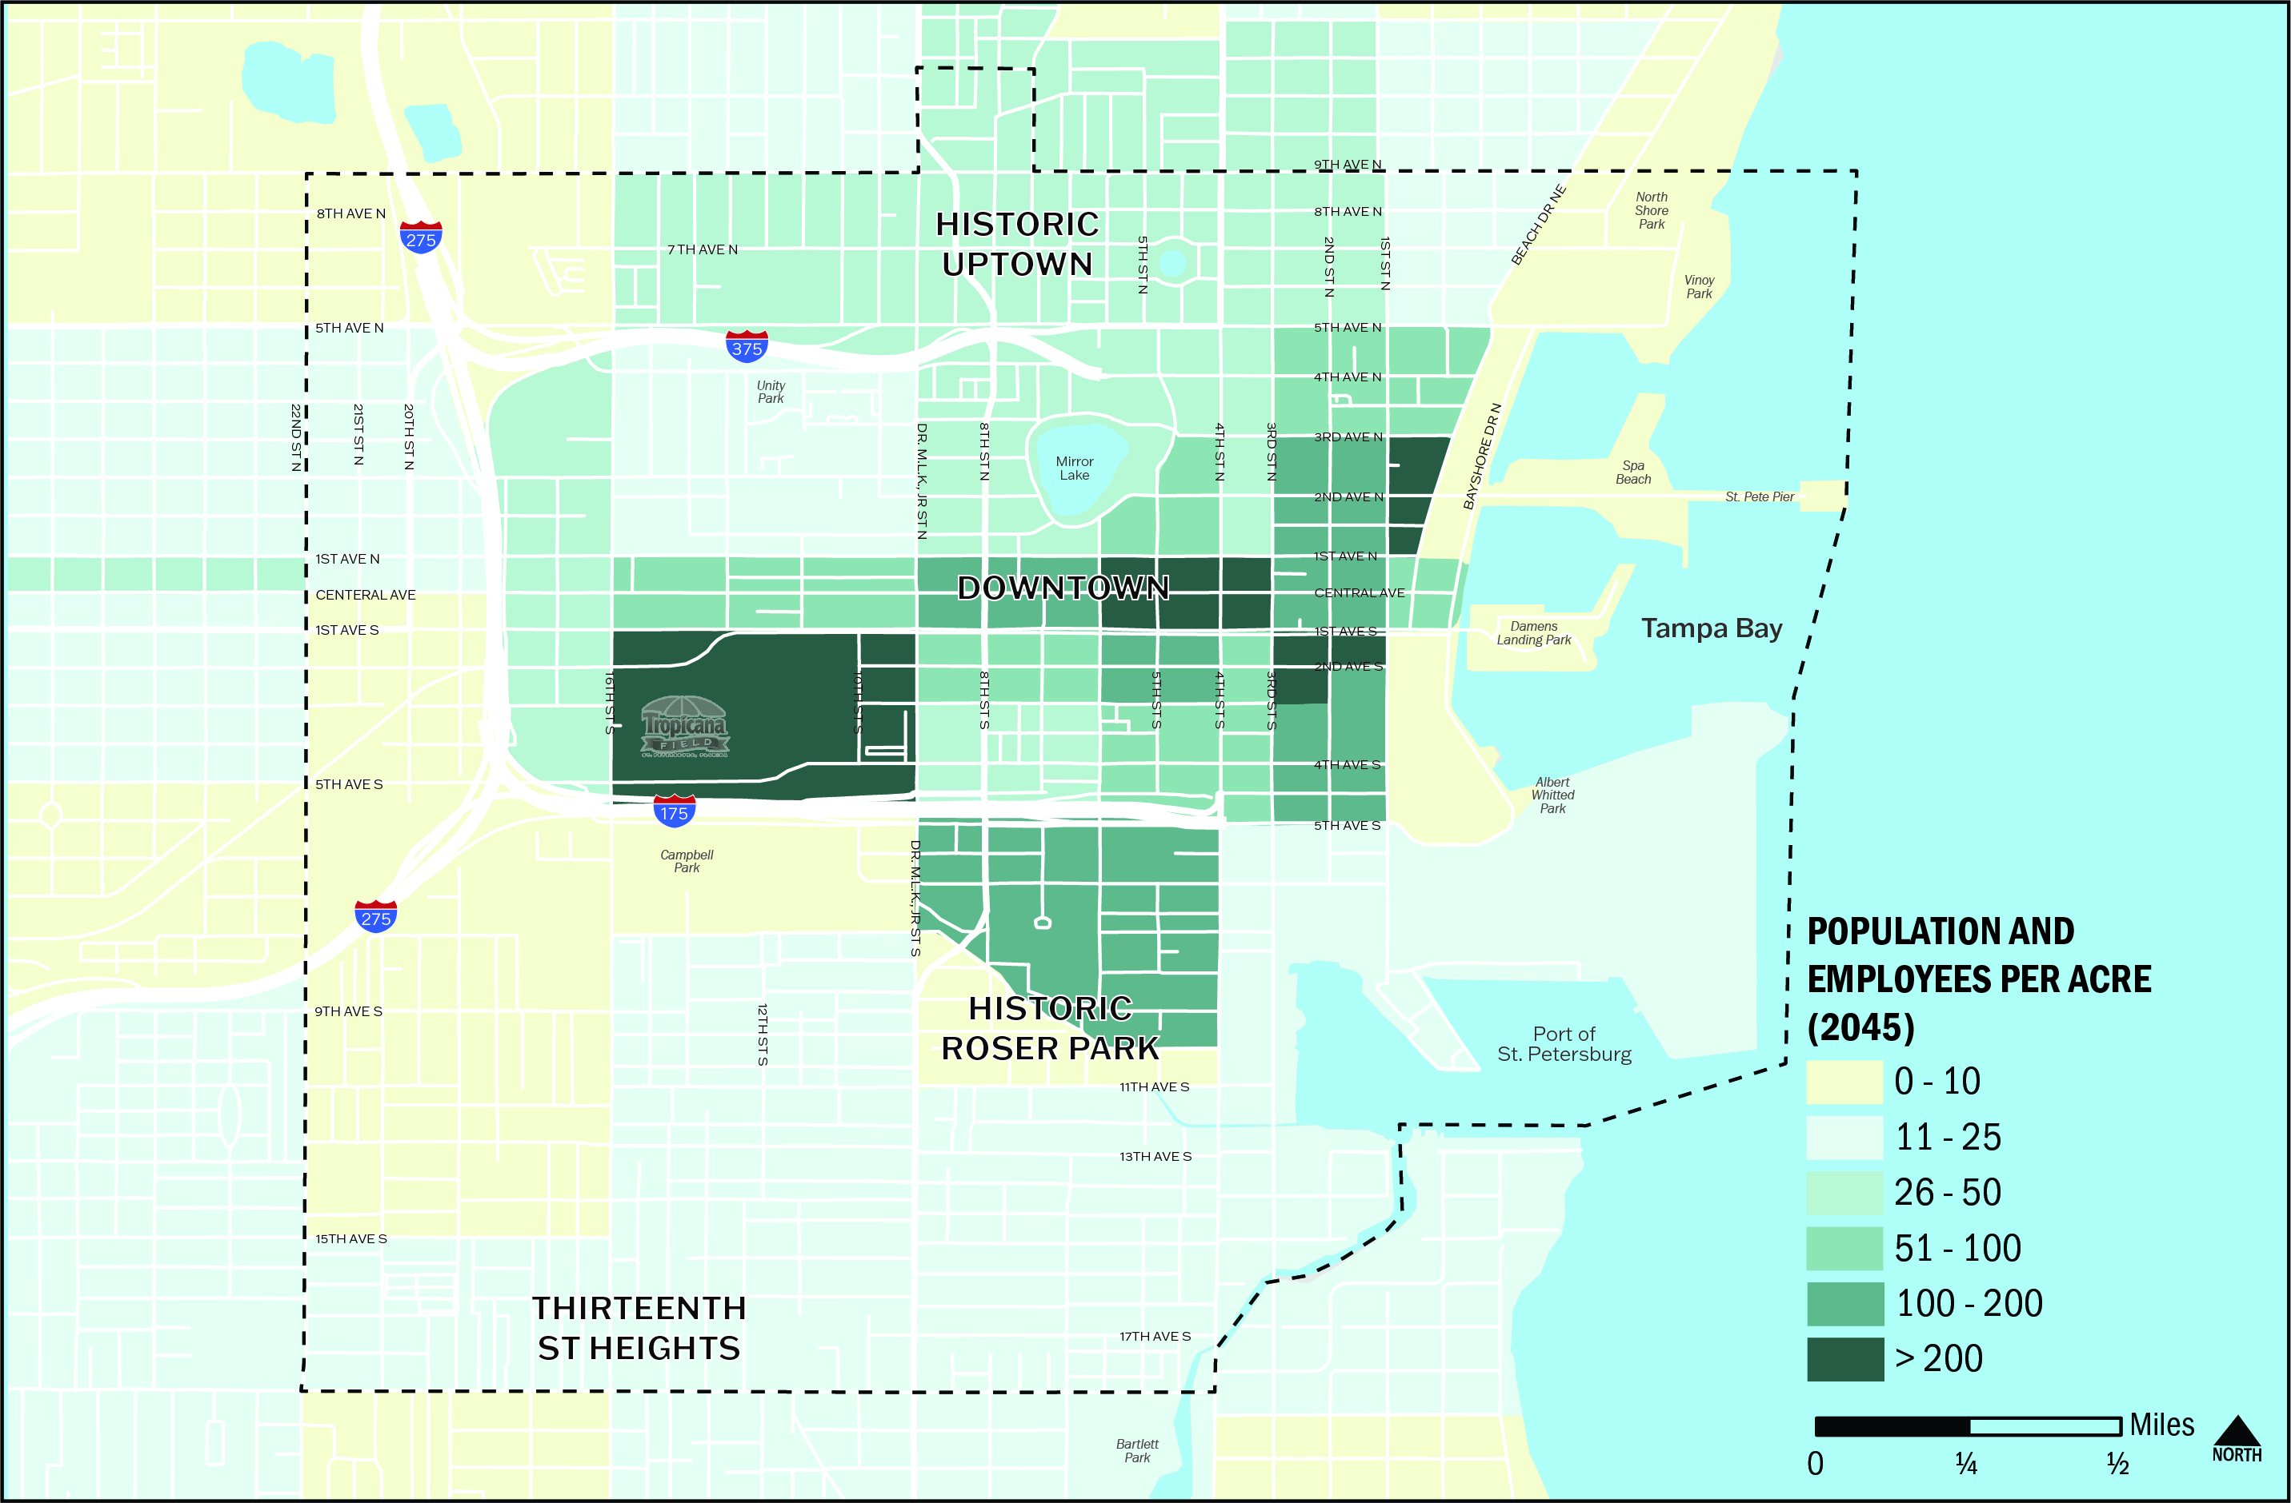
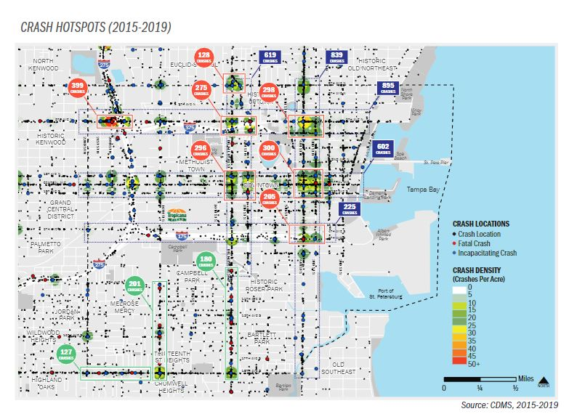
What We’re Seeing in DTSP
Current Population: 30K
Population by 2045: 45K
Current Employment: 45K
Employment by 2045: 58K
43% of all crashes in DTSP occur on one-way pairs
17% of DTSP street network is one-way pairs

Slide 5
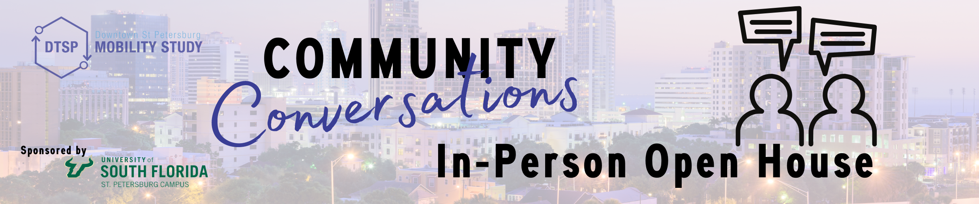
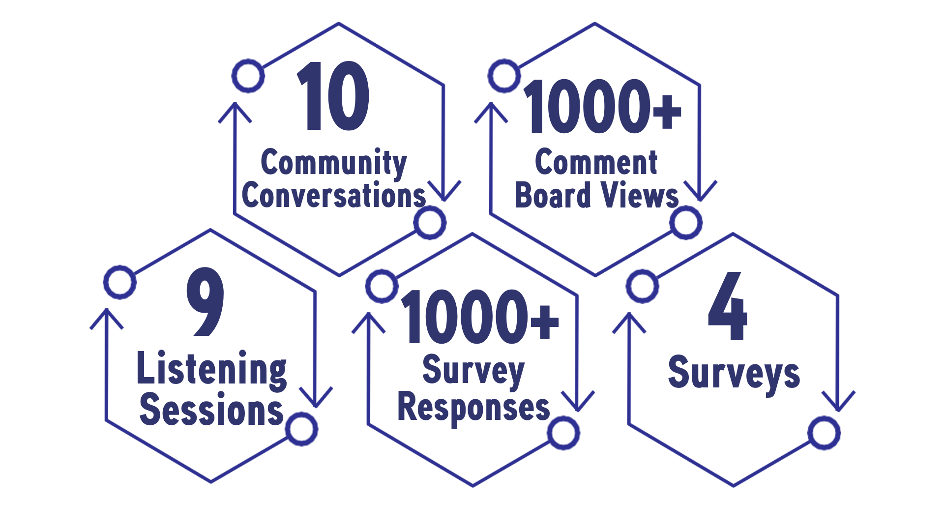
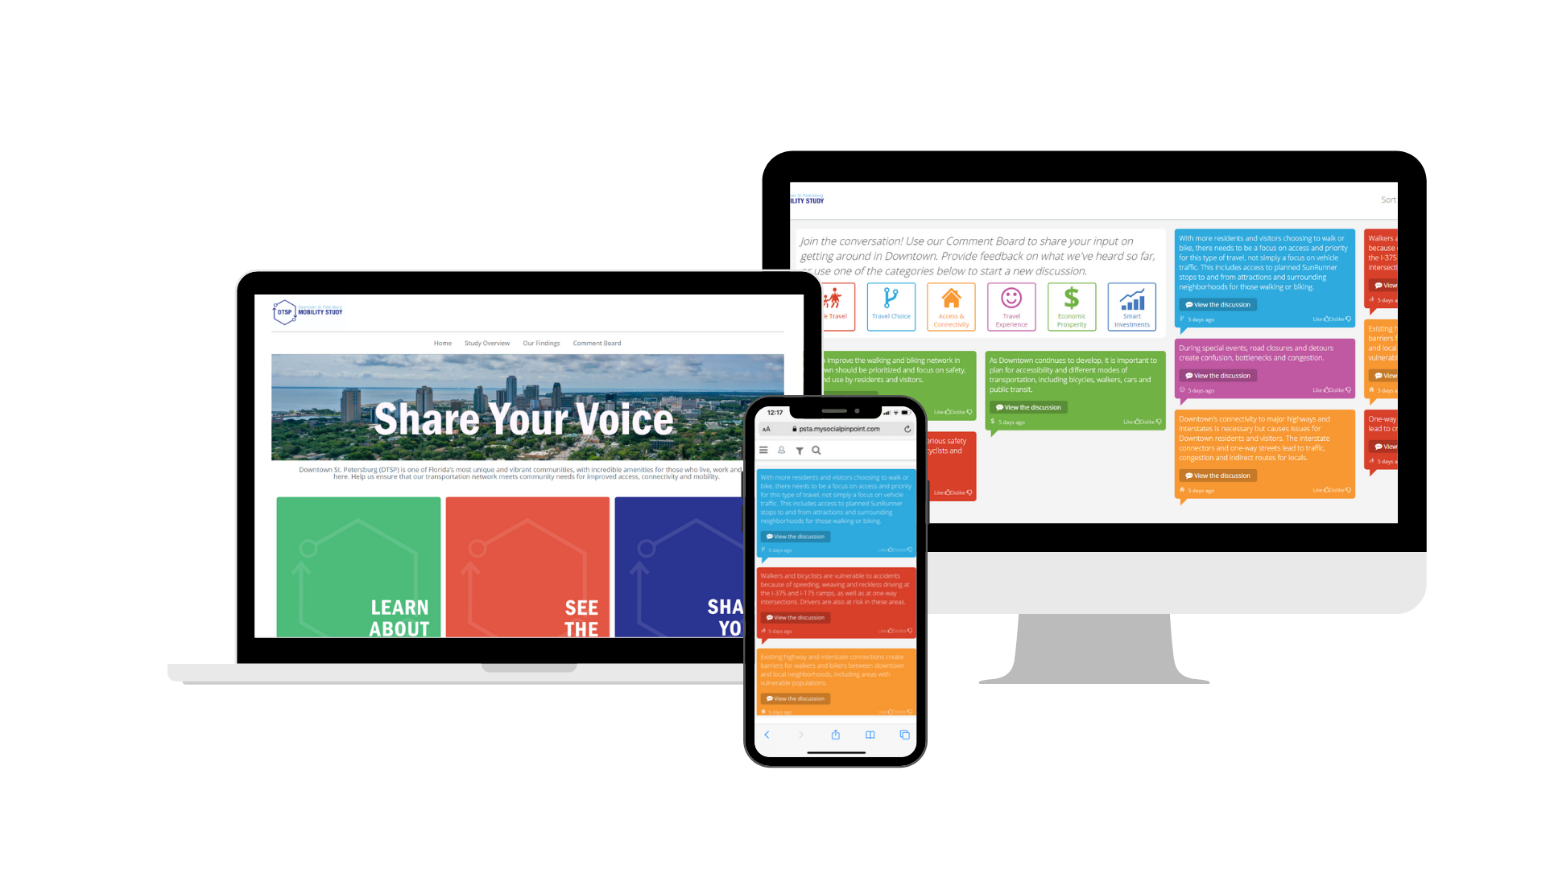
Public Outreach

Slide 6
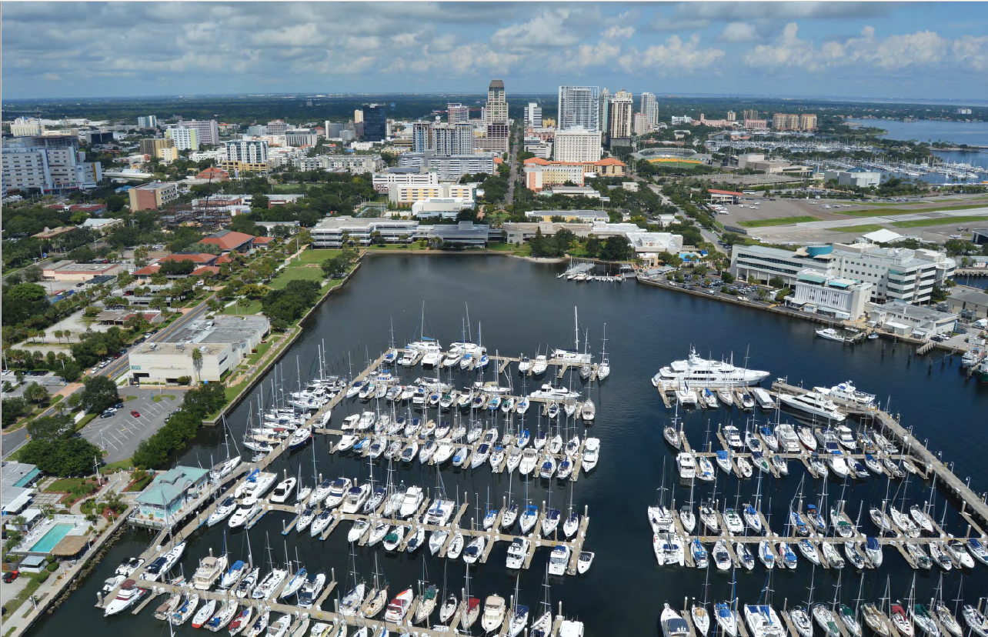
What We’ve Learned
Two-way Streets:
  Are safer than one-way streets
  Improve business accessibility
  Promote more livable communities
18 cities so far in US have transformed their freeways into community assets
Highway Redesign:
  Increases walking and biking
  Encourages economic opportunity
  Can improve environmental quality
  Increases neighborhood connectivity
Ambulance service is more concerned with smoothness of ride than travel time, but emergency response and hospital access concerns must be addressed
Congress for the New Urbanism 2019

Slide 7
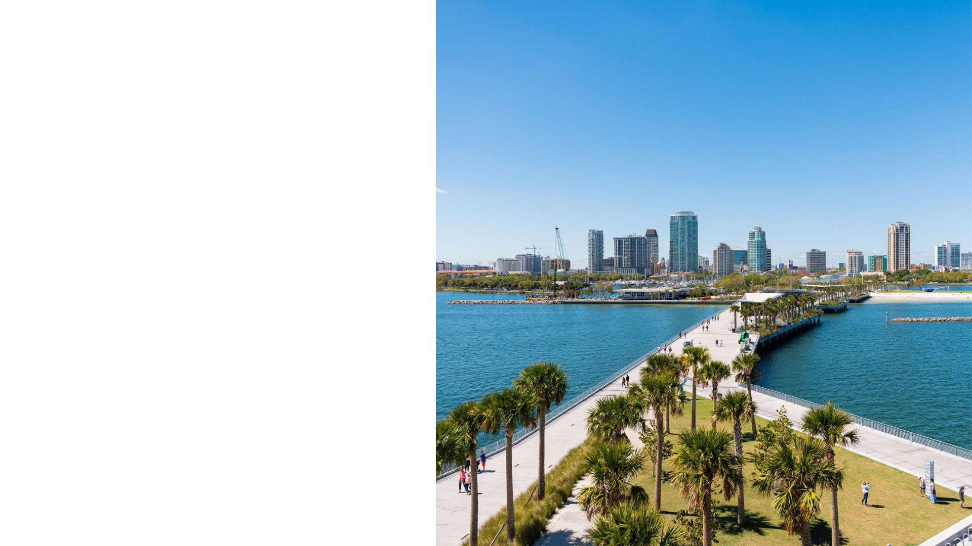

Key Projects
Overview

Slide 8
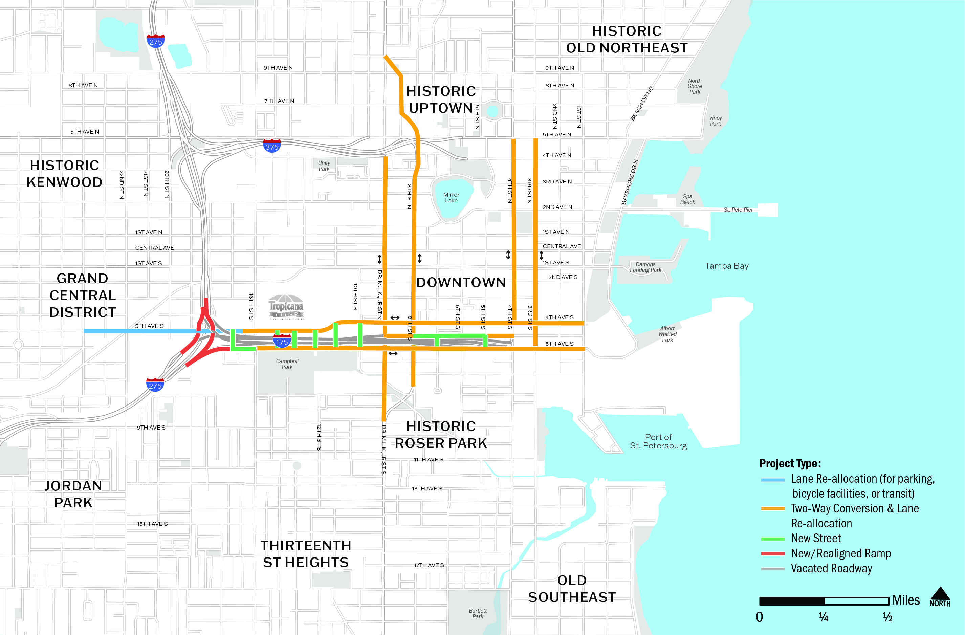
Priority One Projects (Short, Mid, and Long-Term)

Slide 9
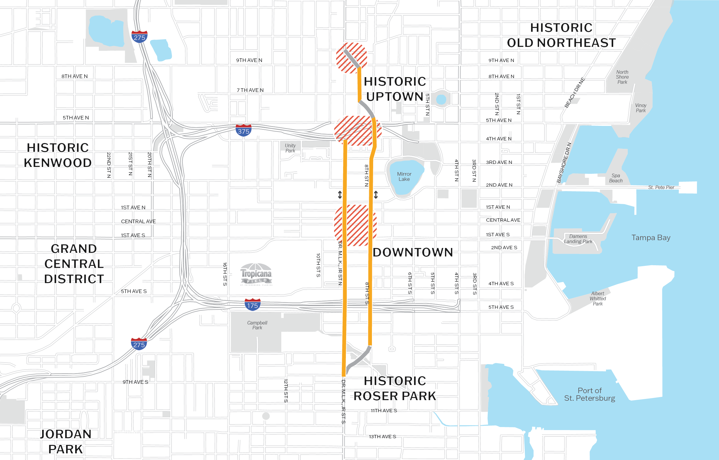
Priority One Project
8th/Dr. MLK, Jr. St Two-Way Conversion & Lane Reallocation
PROJECT HIGHLIGHTS
Short-Term (1-3 Years): Identify concept plans and typical sections for lane reallocation/ two-way conversion
Mid-Term (4-6 Years): City advances the project into final phases based on concept planning results
Exploring funding opportunities for the next phase

Slide 10
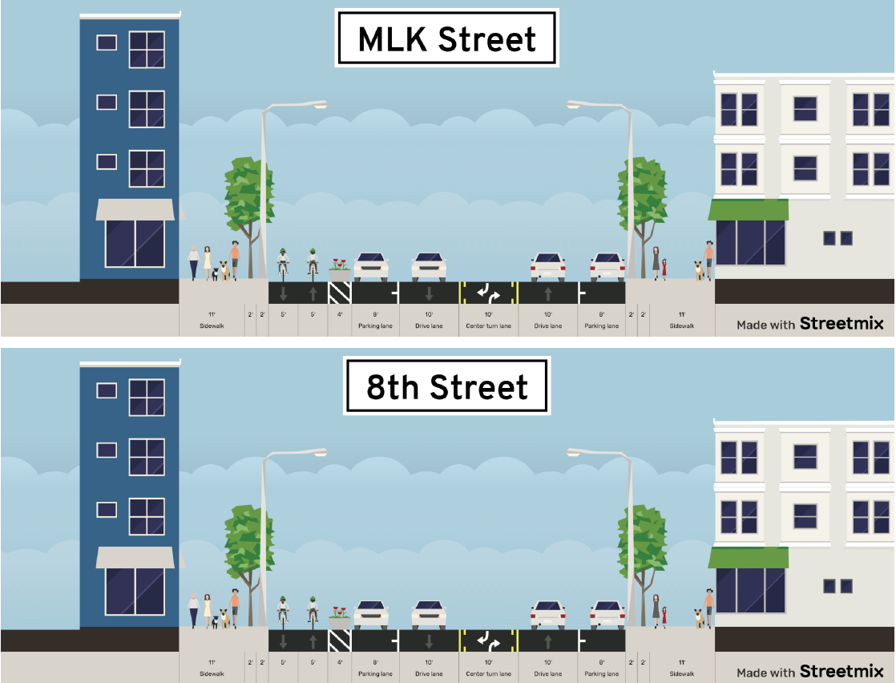
Priority One Project
8th/Dr. MLK, Jr. St Two-Way Conversion & Lane Reallocation
PROJECT OPTIONS
Same cross-section for both streets
Two-way cycletrack
On-street parking both sides
One lane each direction
Two-way center turn lanes to maximize capacity in through lane
Notes:
Make sure to emphasize that these are conceptual options, and number of lanes is based on what was included in the model. We need to do a more specific analysis to determine what the ultimate design will look like in the next phase.

Slide 11

Priority One Project
8th/Dr. MLK, Jr. St Two-Way Conversion & Lane Reallocation
PROJECT OPTIONS
Same cross-section for both streets
Two-way cycletrack
On-street parking both sides
One lane each direction
Two lanes in one direction and one in the other direction for a total of 2 lanes in each direction combined

Slide 12
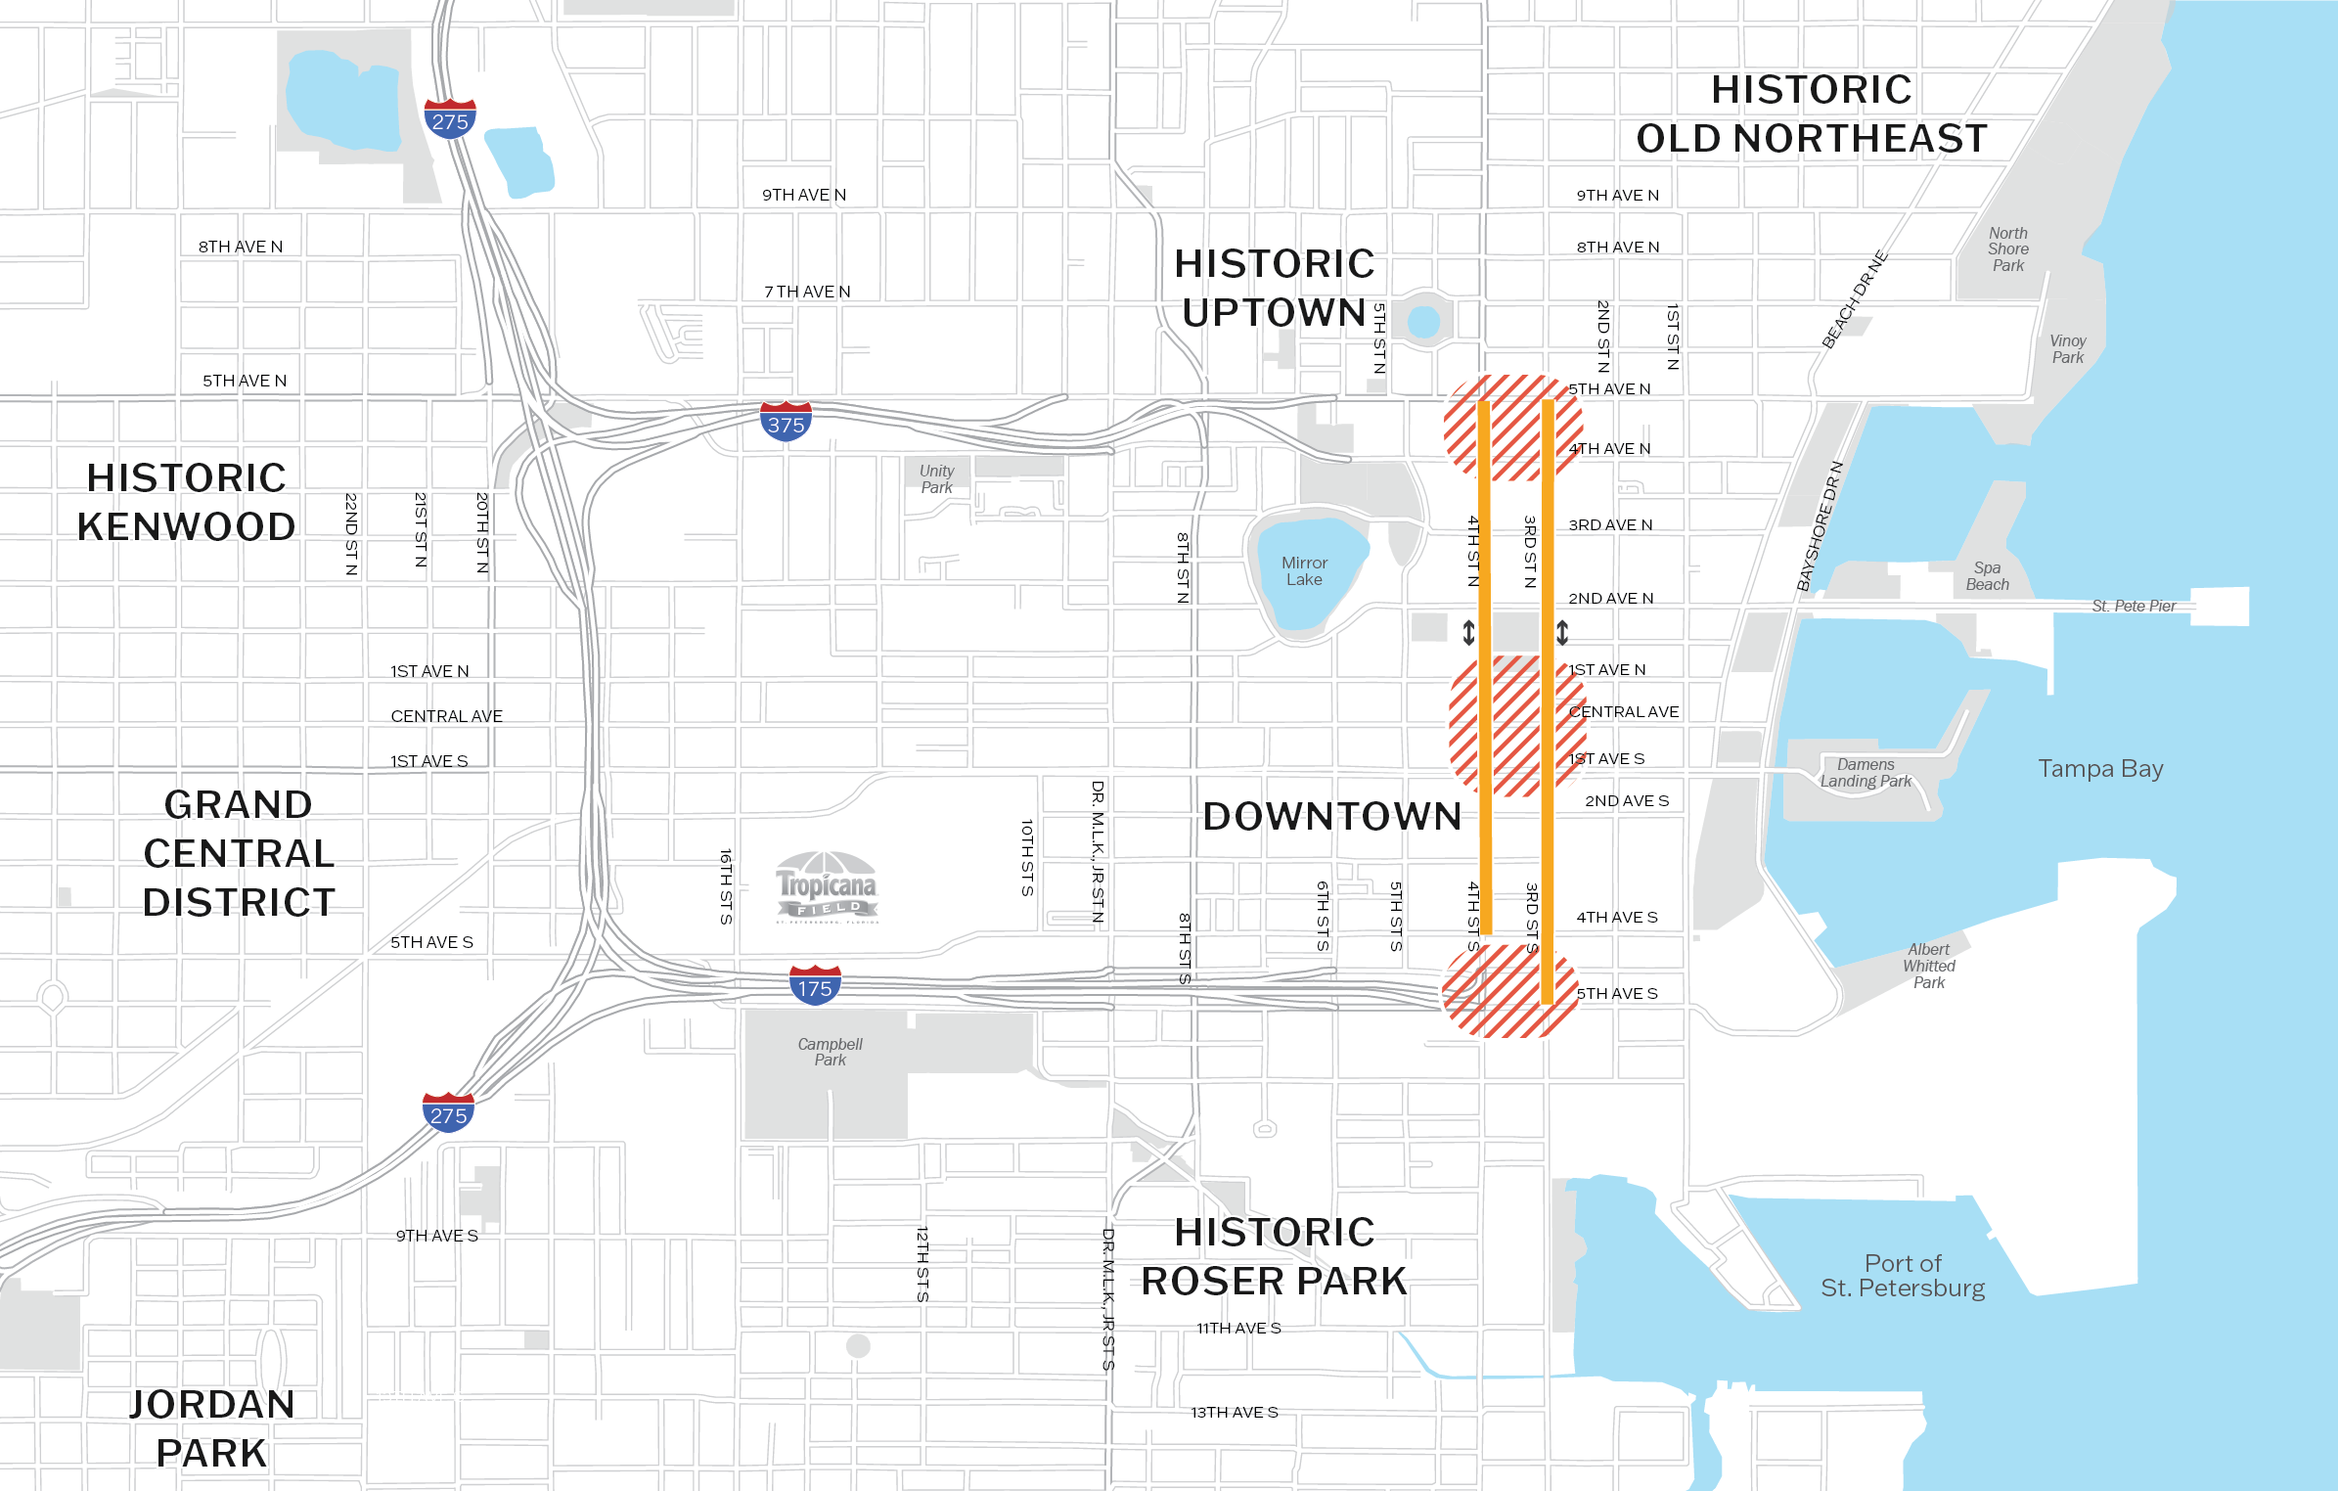
Priority One Project
3rd/4th St Two-Way Conversion & Lane Reallocation
PROJECT HIGHLIGHTS
Short-Term (1-3 Years): Identify concept plans and typical sections for lane reallocation/ two-way conversion
Mid-Term (4-6 Years): City advances the project into final phases based on concept planning results
Exploring funding opportunities for the next phase

Slide 13
Priority One Project
Transit, Traffic & Safety
PROJECT HIGHLIGHTS
Short-Term (1-3 Years): Traffic Signal Priority Analysis to explore options to maintain or improve travel times and access to hospitals
Short-Term (1-3 Years): Study to evaluate safety and operations at the I-275 at 5th Ave N interchange and ramps along I-375
Mid-Term Actions Include:
  Transit Service Modification Study
  Connected Vehicle Technology/ Intelligent Transportation System Strategy & Plan
Exploring funding opportunities for the next phase

Slide 14
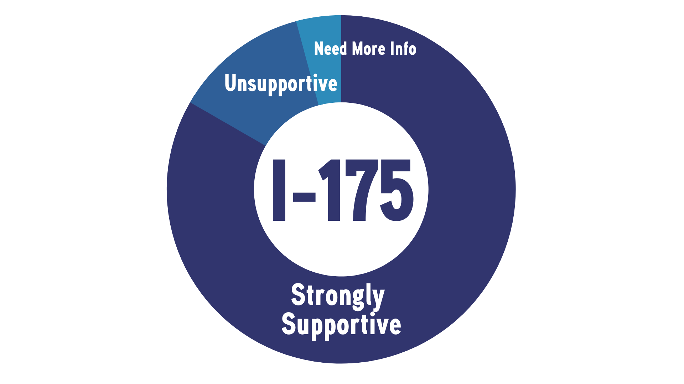
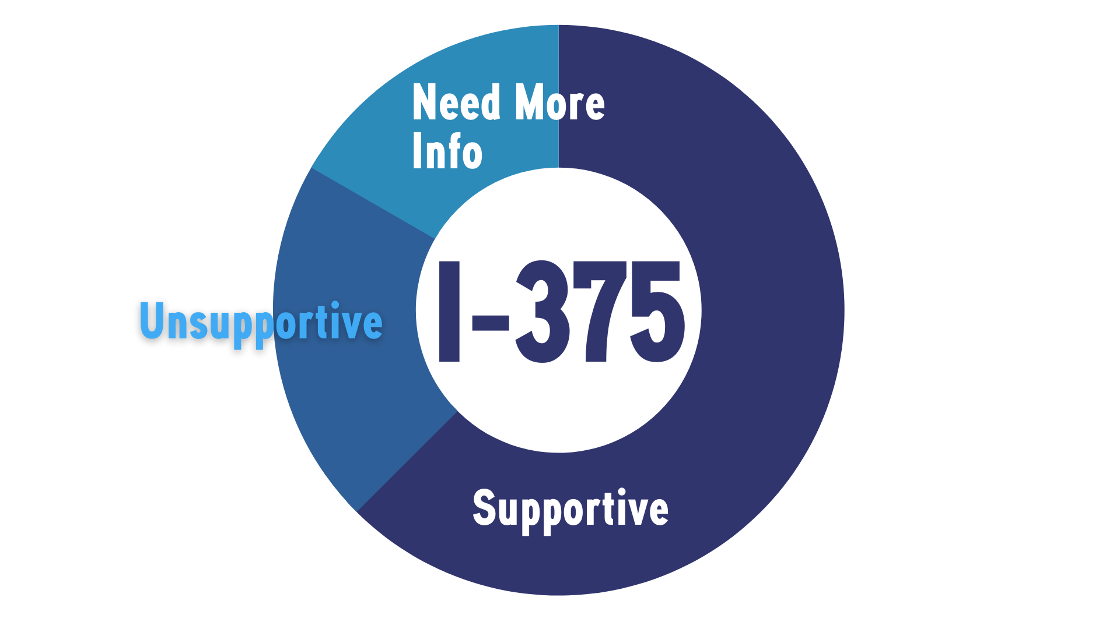
Level of Support
Most respondents are supportive of removing I-175 and I-375. There is a high level of support for the removal or modification of I-175 and a moderate level of support for the removal or modification of I-375.
500+
survey & session participants
500+
survey & session participants
70 participants

Slide 15
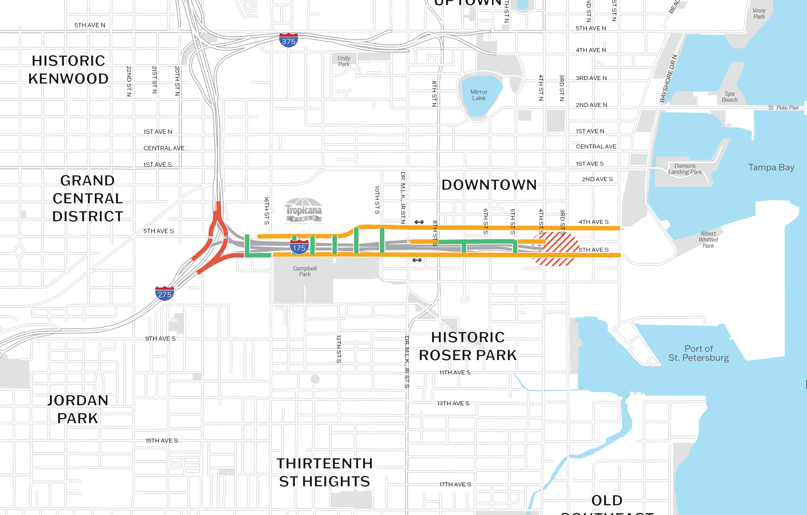
Priority One Project
I-175 Corridor Modifications
PROJECT HIGHLIGHTS
Short-Term (1-3 Years): Conceptual development study to evaluate engineering options for I-175
FDOT has prepared a scope of services for this next phase

Slide 16
Priority One Project
I-175 Corridor Modifications
PROJECT HIGHLIGHTS
FDOT has selected a consultant to develop conceptual alternatives for the redevelopment of I-175
Options considered include: No Build Scenario, Modification, and Removal
Consultant will provide 3 alternatives, potential construction costs, and traffic analysis for anticipated LOS

Slide 17
Priority One Project
I-175 Corridor Modifications
PROJECT HIGHLIGHTS
Short-Term (1-3 Years): Land use, urban design, equity, and transportation study to evaluate options for I-175, 4th & 5th Ave S
Grass roots effort to evaluate community desires and determine next steps
Study how land can be used if spur is removed/modified (i.e. affordable housing)
Exploring funding opportunities for this next phase

Slide 18
RECONNECTING COMMUNITIES PILOT PROGRAM
Purpose: reconnect communities through the removal, modification, or mitigation of barriers such as transportation facilities that separate communities and impact mobility and accessibility
Funding Mechanism: Competitive Grant
Funding Amount: $1,000,000,000 - construction; planning
Notice of Funding Availability to be issued TBD
Source: USDOT Upcoming NOFA Announcements, 2022

Slide 19
Priority One Project
I-175 Corridor Modifications
PROJECT HIGHLIGHTS
Mid-Term (4-6 Years): PD&E Study to evaluate options for I-175, I-275 ramps, 4th & 5th Ave S, & Trop site connections
Other Mid Term Actions Include:
  I-175 Land Disposition Strategy
  4th/5th Ave S Two-Way Conversion Study
  I-175 Interchange Modification Analysis
Long Term (7-14 Years): Design & Engineering, ROW & Construction

Slide 20
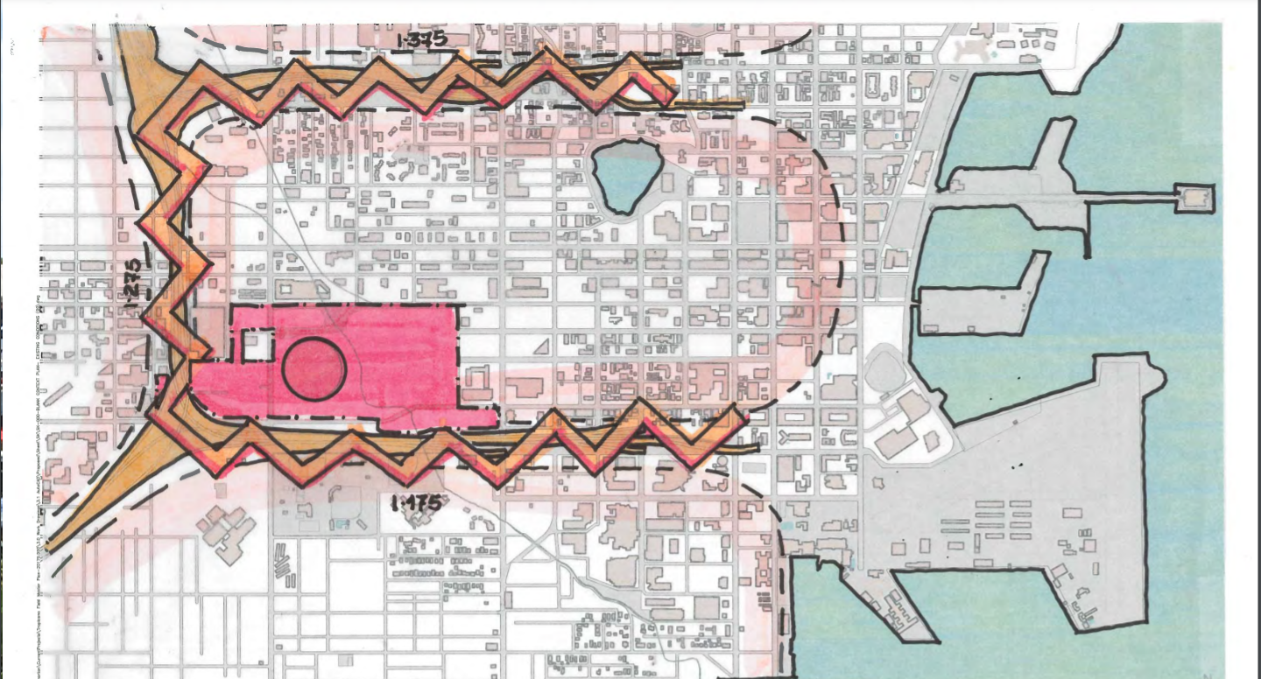

Slide 21
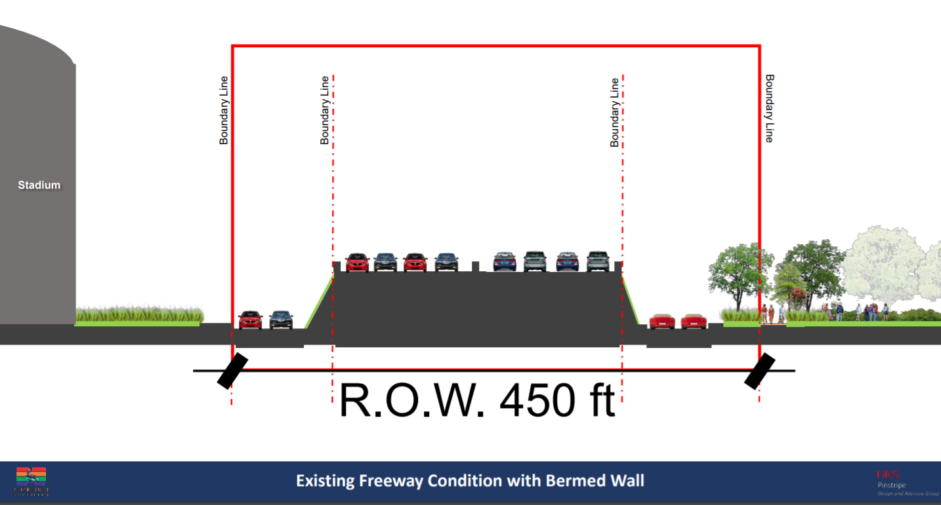

Slide 22
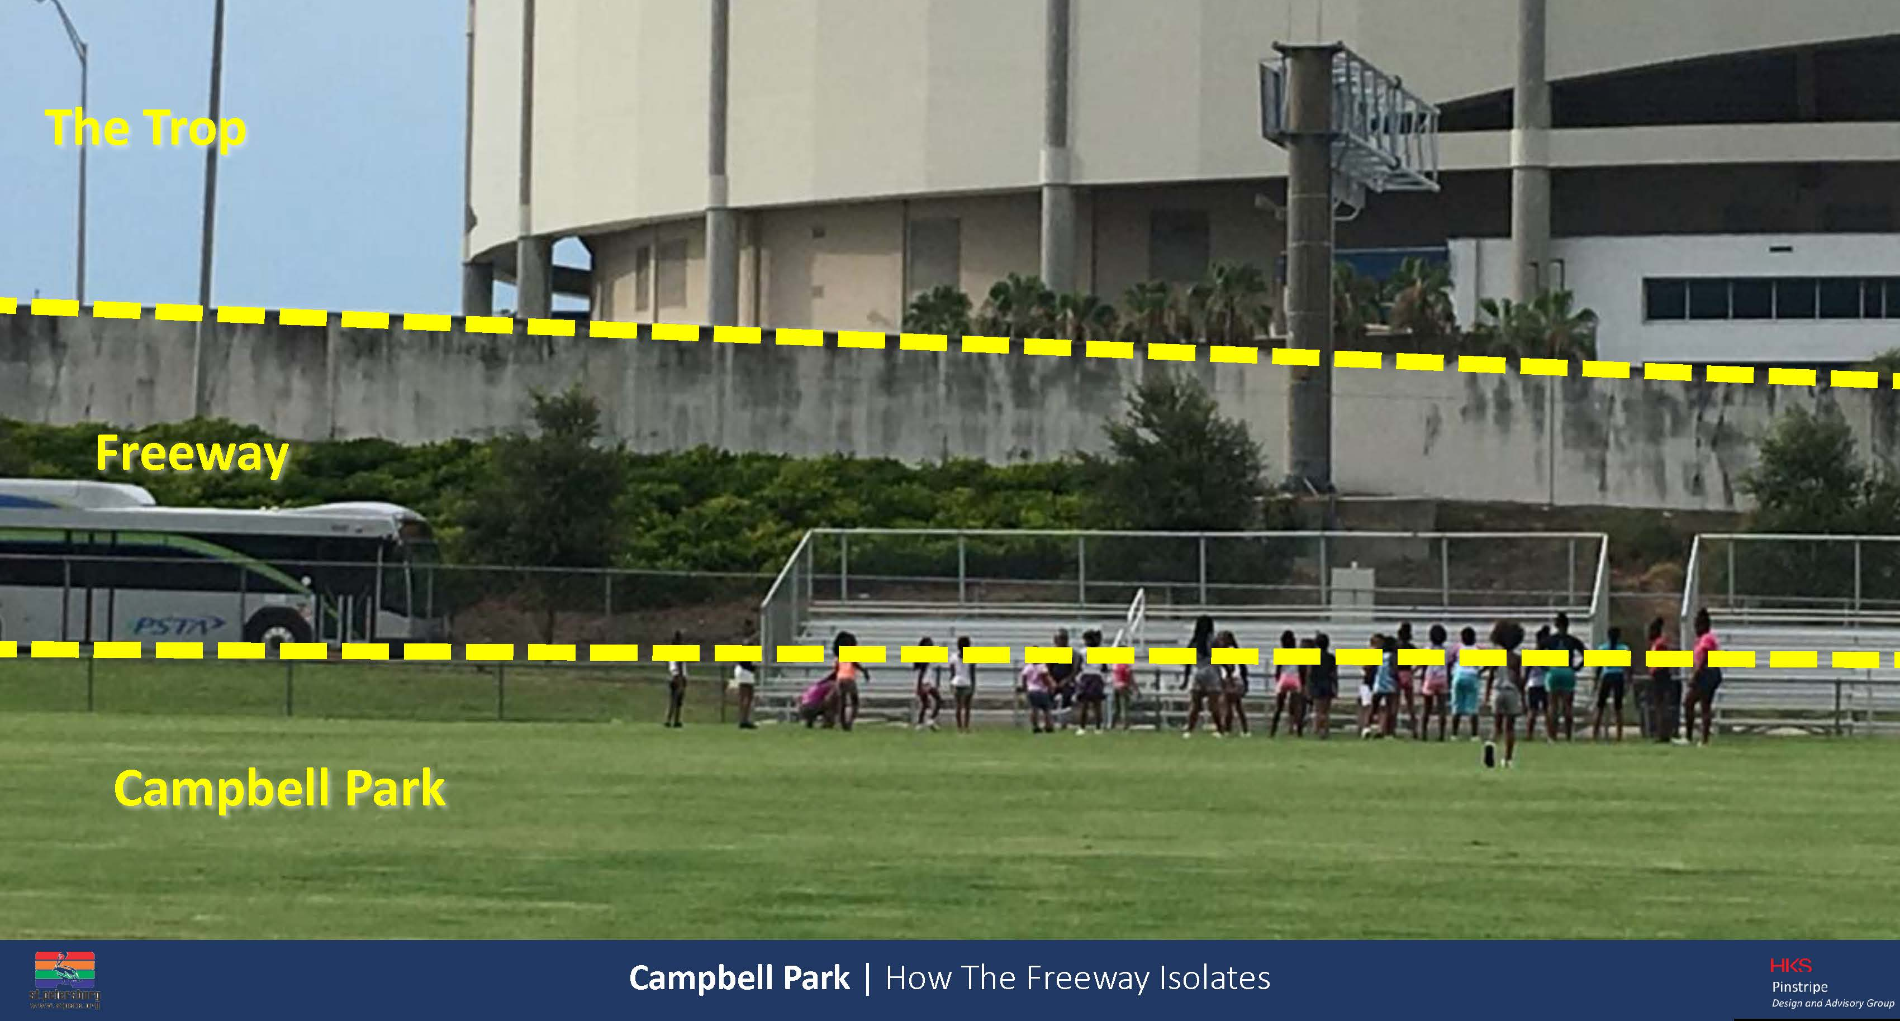

Slide 23
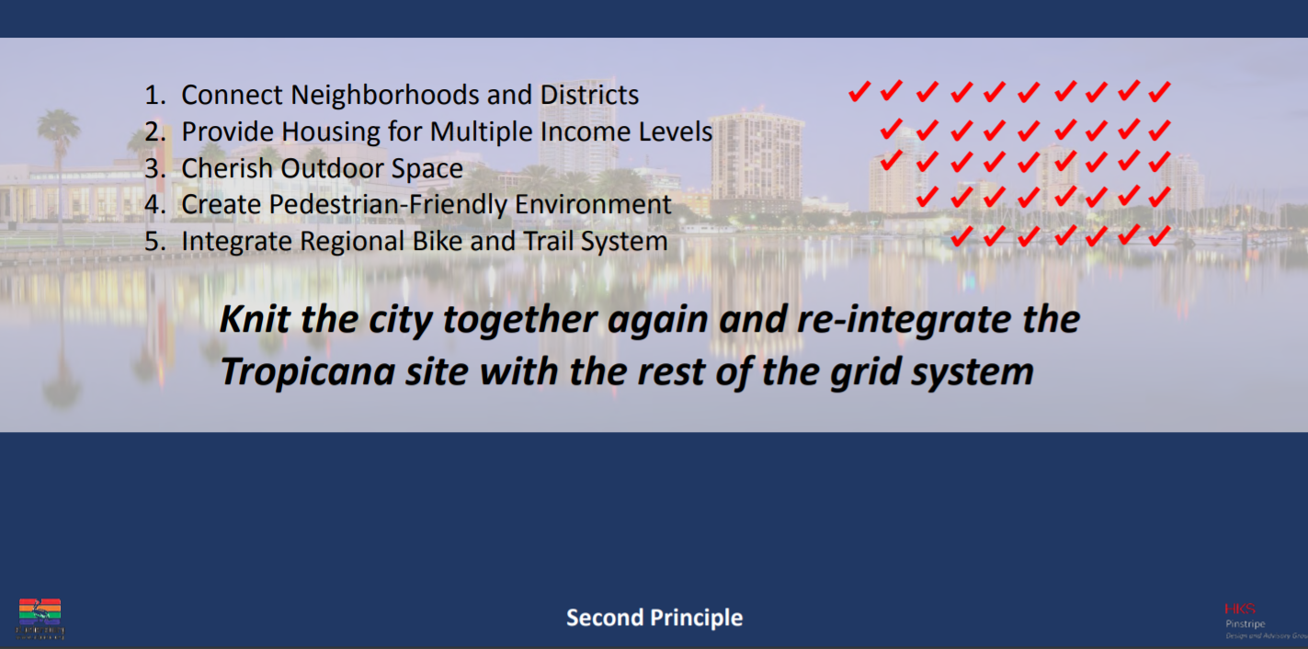

Slide 24
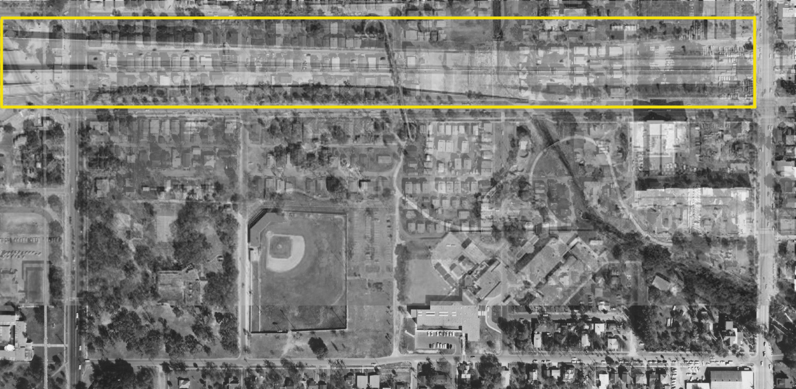

Slide 25
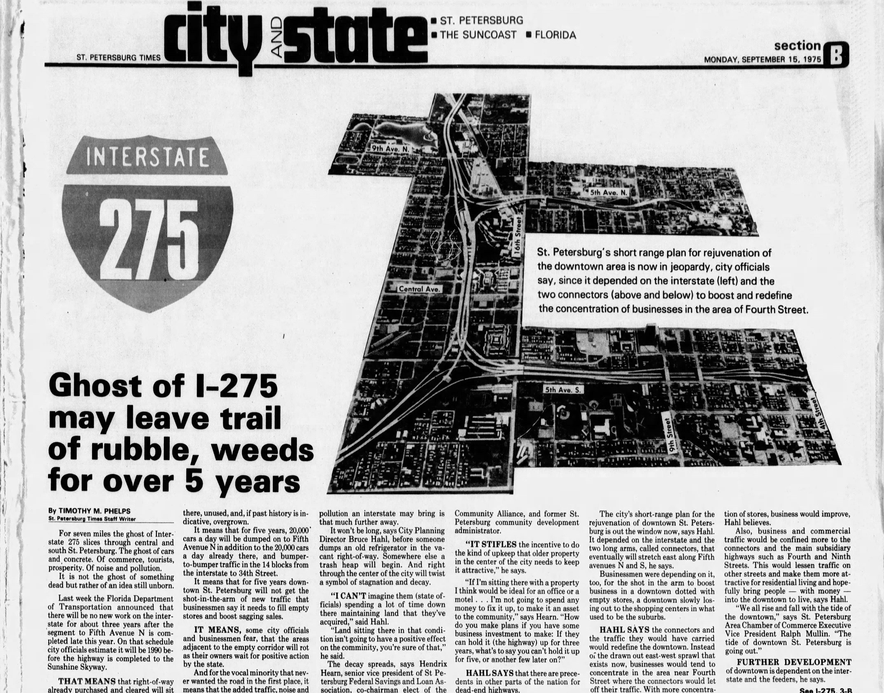
“The connectors and the traffic they would have carried would redefine the downtown. Instead of the drawn out east-west sprawl that exists now, businesses would tend to concentrate in the area near Fourth Street where the connectors would let off their traffic. With more concentration of stores, business would improve...”

Slide 26
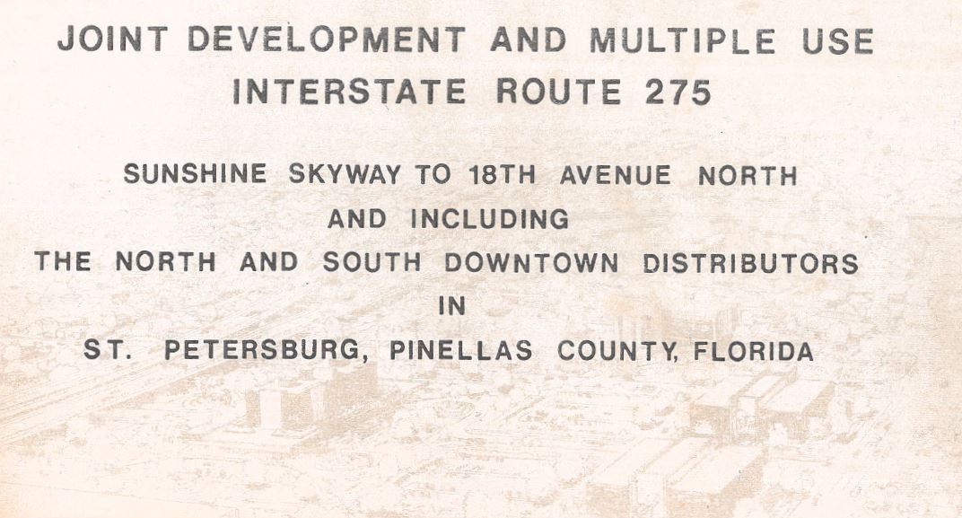

Slide 27
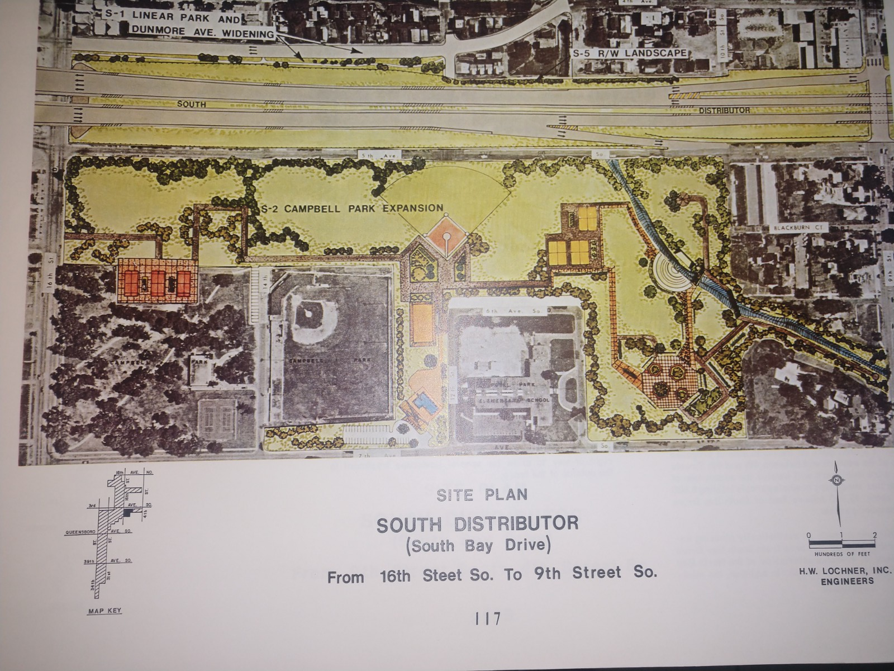

Slide 28
Displacement Effects of I-175 (South Distributer/South Bay Drive)
“Major relocation problems occur when the family has marginal means and therefore is not able to cope with the non-reimbursable expenses of relocation.”
“Fiscal problems encountered by the poor does not exhaust the problems that they face. Specific attention should be directed to the social aspects.”
(October, 1974 Lochner Study)

Slide 29
Displacement Effects of I-175 (South Distributer/South Bay Drive)
163 parcels acquired
278 “Relocatee Units” (A family, individual, business, or non-profit organization)
  “A community, like any group, is essentially a system of social interaction.”
  “The two most important aspects of community are locality and quality of interaction.”
“South Bay Drive will act as a deterrent to social interaction between those who live north of 5th Avenue South and those who live south of 5th Avenue South”

Slide 30
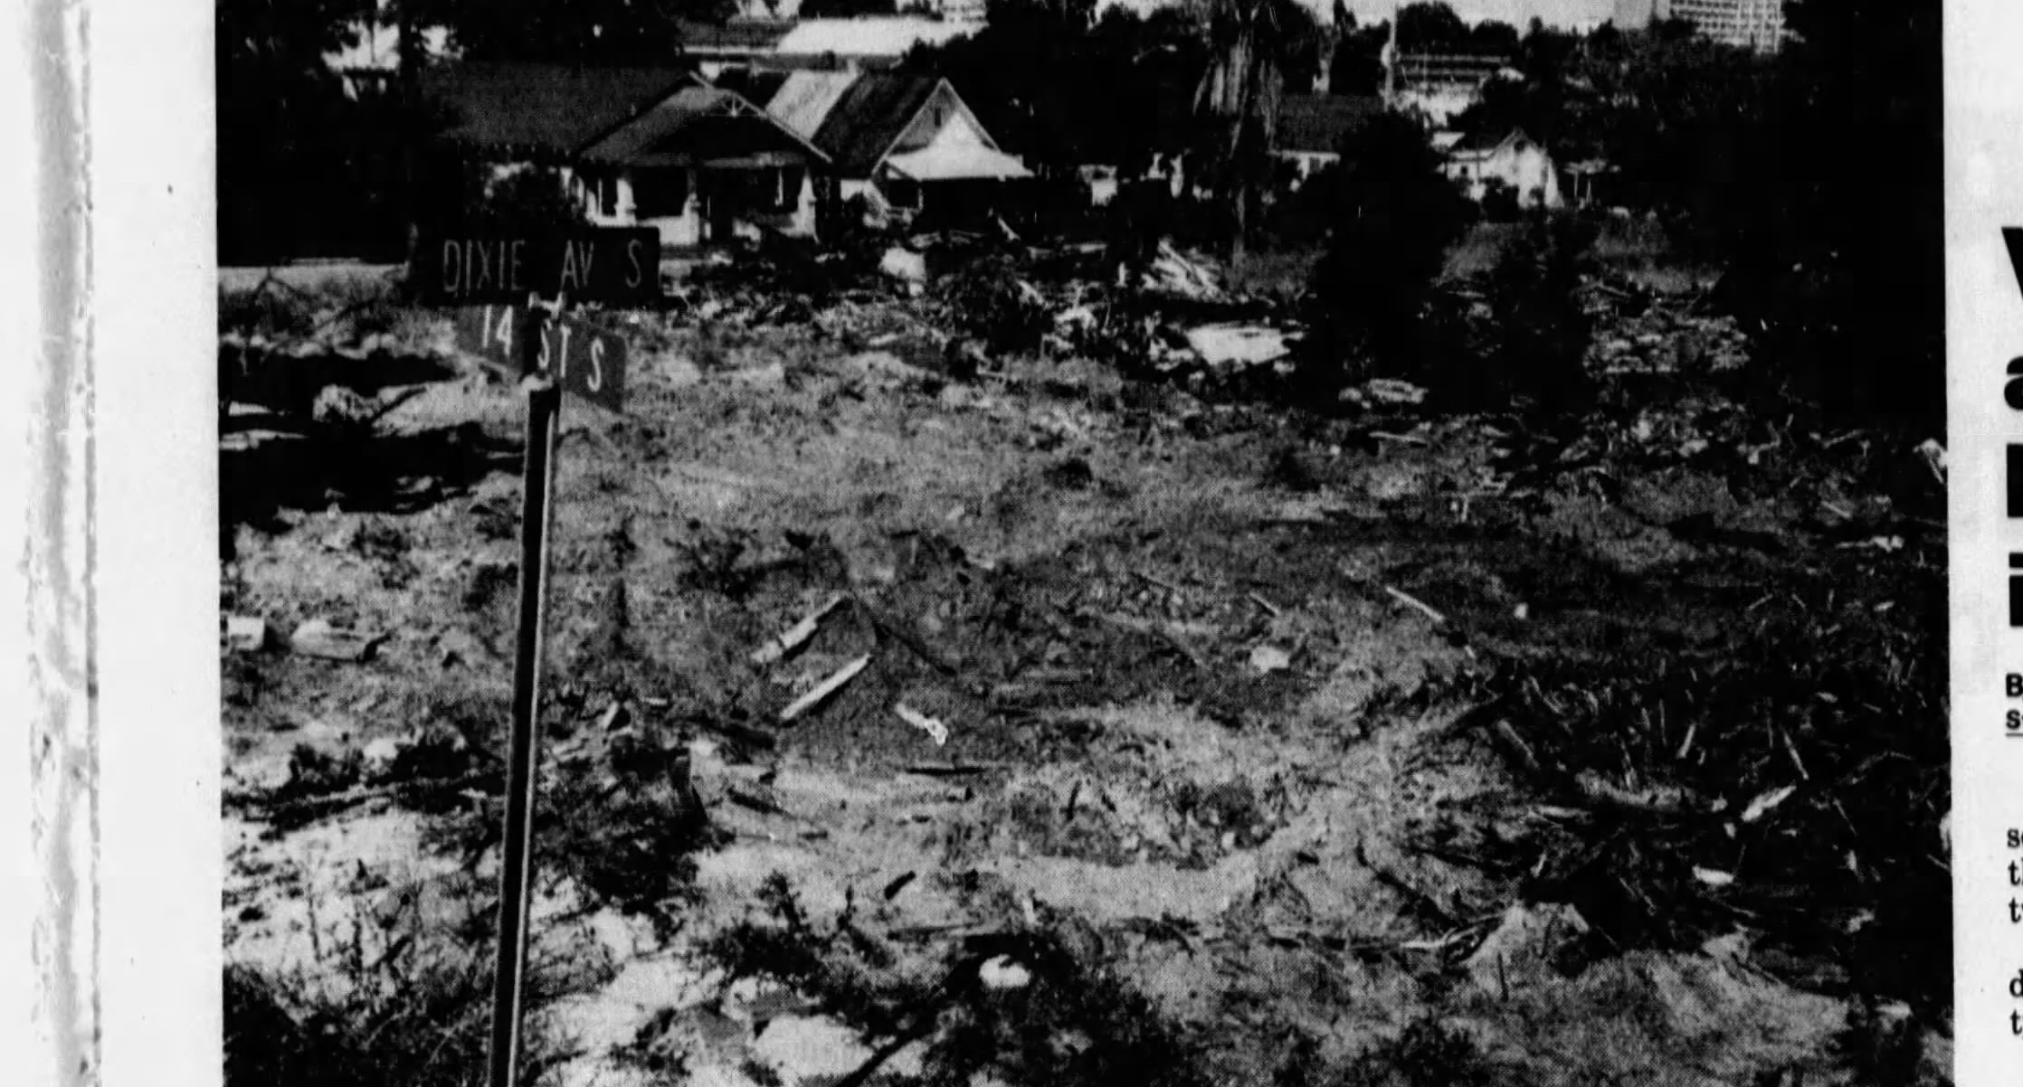

Slide 31
All Comments Received during DSPMS presentation to
Campbell Park Neighborhood on 11-1-21:
18:21:21 From Steve Morrison to Everyone:
Full speed ahead on I-175 removal, please tear down that wall !!
18:22:08 From Josette Green to Everyone:
I support the removal of I-175 ASAP.
18:22:35 From Kari to Everyone:
Thank you for the presentation. I'm in full support of the I-175 removal
18:23:03 From Josette Green to Everyone:
Indeed it is a wall and continues to support racial inequity. I want a unified city.
18:23:05 From Stew H to Everyone:
175 removal seems even more feasible than I had thought! Excited to see where this goes
18:23:16 From Steve Morrison to Everyone:
In addition, the two way conversions on 8th / MLK and 3rd / 4th seem like very positive no brainers. Slow things a bit, make things safer, and encourage multi-modal personal transportation
18:23:40 From Madeline Morales to Everyone:
We are in support of the removal of I-175.

Slide 32
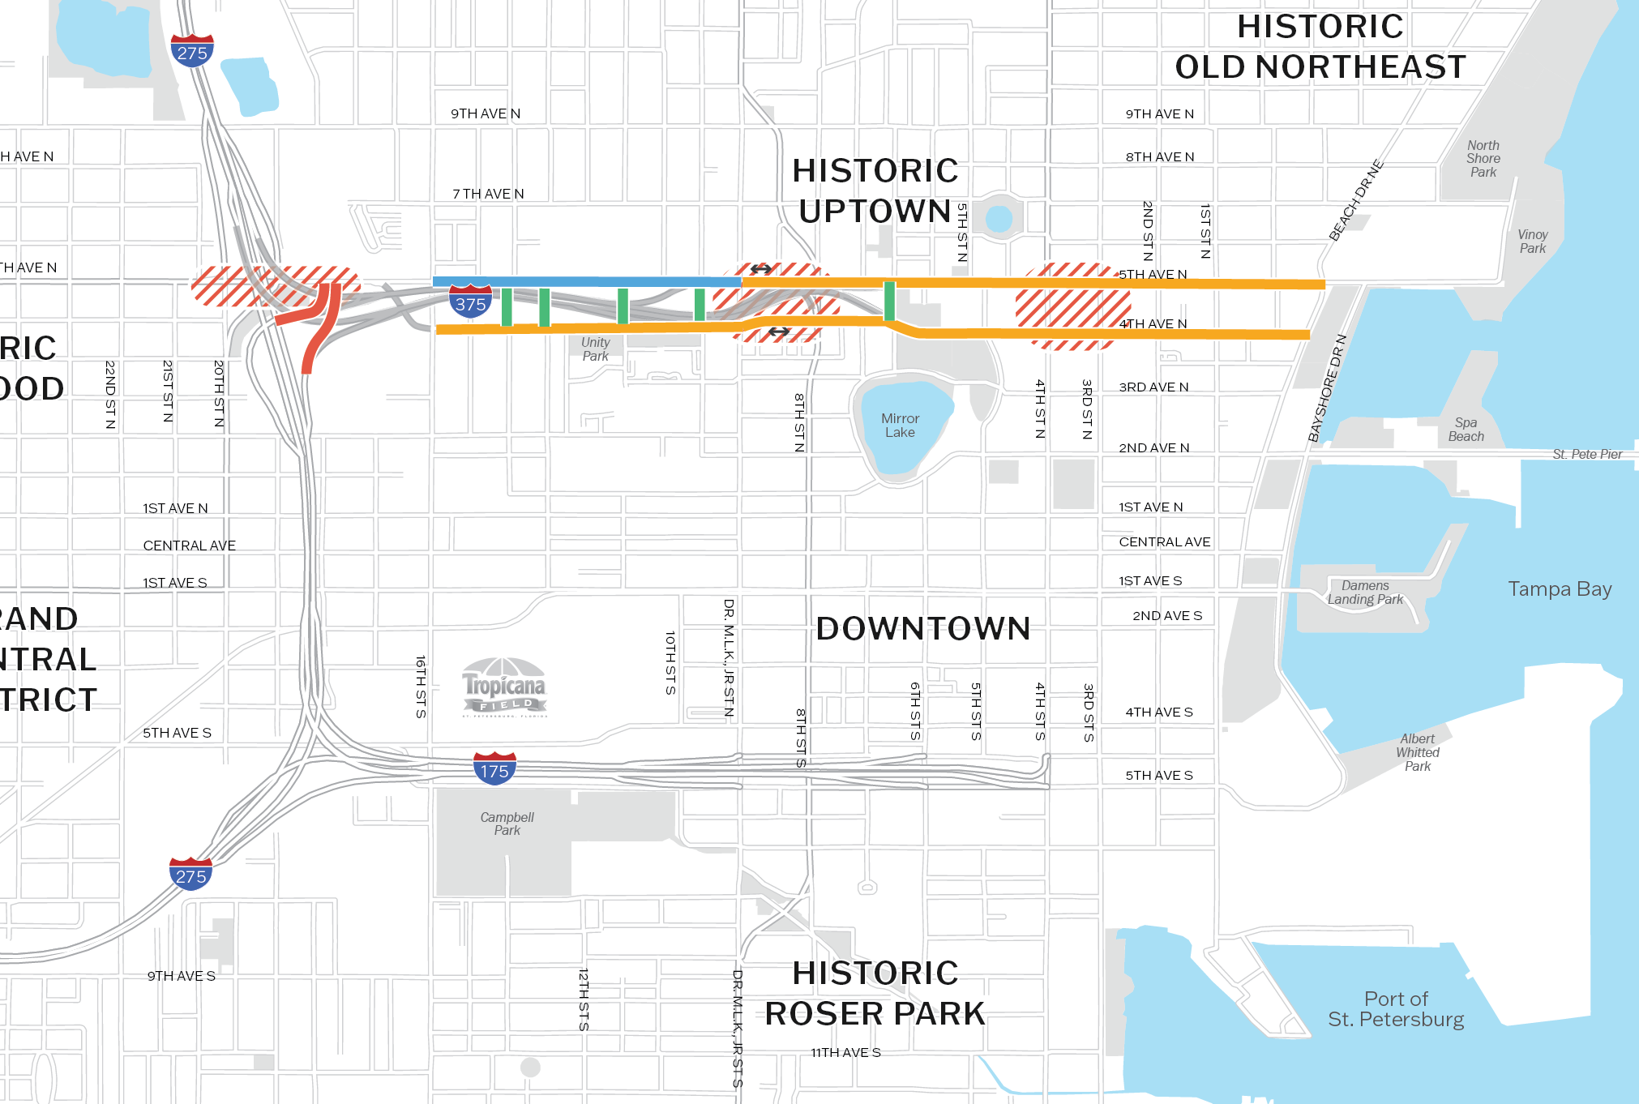
Priority Two Project
I-375 Corridor Modifications
PROJECT HIGHLIGHTS
Extended Term (15+ Years): PD&E Study to evaluate options for I-375, I-275 ramps, 4th & 5th Ave N
Other Extended Term Actions Include:
  DTSP Mobility Study Update
  I-375 Land Disposition Strategy
  I-375 Interchange Modification Analysis
  Future Phases for Design & Engineering, Right-of-Way & Construction

Slide 33


A Journey to Safety
Engineering & Design
DTSP Project Concepts
Public Engagement
Construction
Project Development & Environment Study
Capping Alternative
Boulevard Alternative
Right-Sizing Alternative
Cultural Resource Assessment
Park, Open Space or Development

Slide 34
Next Steps
Council Accepts Study
Present to Forward Pinellas Committees/Board
Forward Pinellas Board Accepts Study

Slide 35



Questions?
Whit Blanton, FAICP
wblanton@forwardpinellas.org
ForwardPinellas.org/DTSP
Notes:
10 MINUTES Q&A

Slide 36
Level of Support
Feb 2020
Project Kickoff
Jul - Dec 2020
Survey Launched, Listening Sessions Conducted, Online Comment Board Created
Dec 2020- June 2021
Scenarios Developed
June 2021
Listening Sessions Conducted, Survey Launched, Scenarios Refined
June – Oct 2021
Project Concepts Developed
Oct 2021-Feb 2022
Listening Sessions Conducted, Stakeholder Meetings Conducted
Dec 2021-Feb 2022
Recommendations Formed
Most respondents are supportive of removing I-175 and I-375. There is a high level of support for the removal or modification of I-175 and a moderate level of support for the removal or modification of I-375.
500+
survey & session participants
500+
survey & session participants
70 participants

